Slide 1
Application on
trees
DATA STRUCTURES (18CS32)
S MERCY
ASST. PROFESSOR
INFORMATION SCIENCE AND ENGINEERING
POOJA HARIHAR -1BI20IS061

Slide 2
TRIE

Slide 3
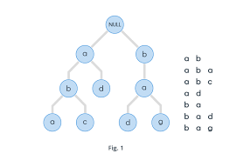
TRIE
Trie is an ordered multi-way tree data structure that is used to store strings over an alphabet.
A multiway tree of order m is one which can have m children.
Trie allows strings with similar prefixes to use same prefix data and store tails as a separate data.
We use a trie to store pieces of data that have a key and possible value.
Here, we’ll use data whose keys are strings

Slide 4
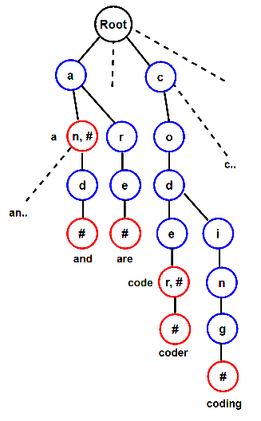
PROPERTIES
All the descendants of a node have a common prefix of the string associated with that node
The root is associated with the empty string.
Keys tend to be associated with leaves, though some inner nodes may correspond to keys of interest.
Hence, keys are not necessarily associated with every node.

Slide 5
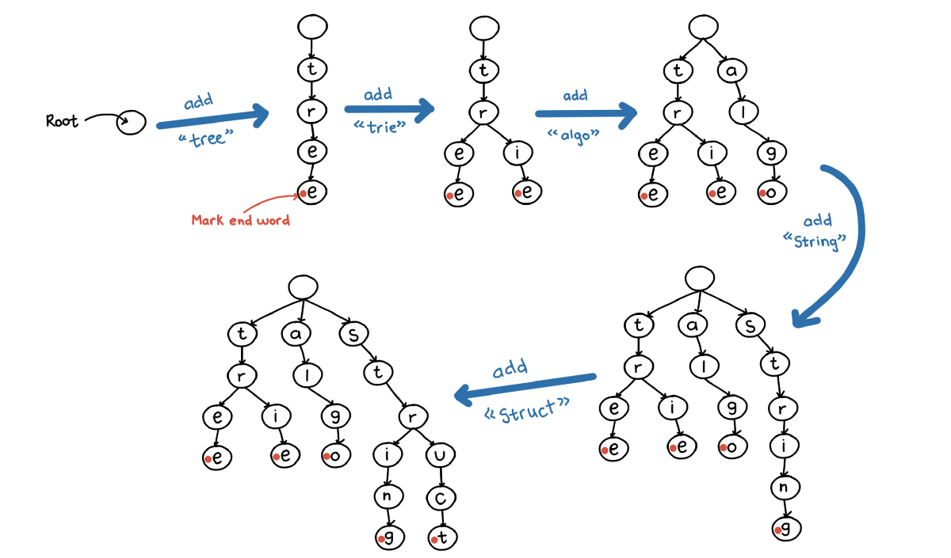

Slide 6
INSERTION IN TRIE
Every letter of the input key (word) is inserted as an individual in the Trie_node. Note that children point to the next level of Trie nodes.
The key character array acts as an index of children.
If the present node already has a reference to the present letter, set the present node to that referenced node. Otherwise, create a new node, set the letter to be equal to the present letter, and even start the present node with this new node.
The character length determines the depth of the trie.

Slide 7
EXAMPLE
ROOT
A
M
R
T
N
G
A
Y
I
D
O
M
‘/0’
N
R
M
‘/0’
I
A
E
‘/0’
S
W
‘/0’
‘/0’
‘/0’

Slide 8
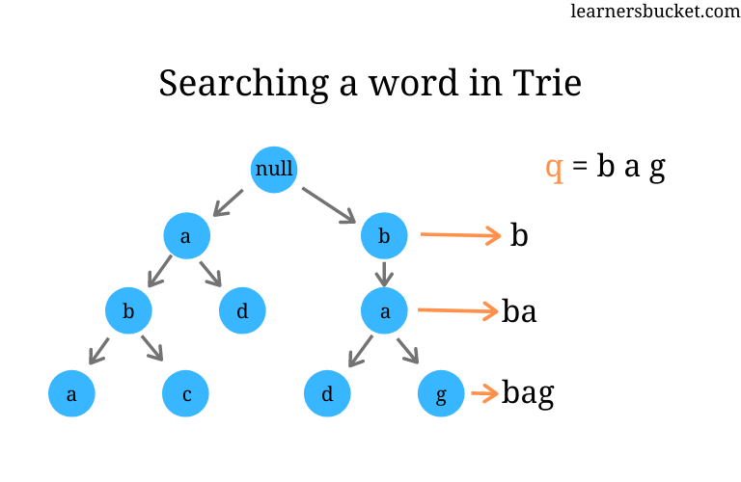
SEARCHING
How to search a pattern in the built Trie?
Following are steps to search a pattern in the built Trie.
1) Starting from the first character of the pattern and root of the Trie, do following for every character.
…..a) For the current character of pattern, if there is an edge from the current node, follow the edge.
…..b) If there is no edge, print “pattern doesn’t exist in text” and return.
2) If all characters of pattern have been processed, then print print all indexes where pattern is present. To store indexes, we use a list with every node that stores indexes of suffixes starting at the node.

Slide 9

APPLICATION OF TRIE
Autocomplete is the most important application of Trie Data structure. It is an mechanism in which the device software predicts the rest of a word a user is typing based on the string prefix.
Auto complete feature speeds up interactions between a user and the application and improves user experience.Auto complete feature is more accurate when there are limited number of possible words or when some words are more commonly used.

Slide 10
ALGORITHM
Search for the given query using the standard Trie search algorithm.
If the query prefix itself is not present, return -1 to indicate the same.
If the query is present and is the end of a word in Trie, print query. This can quickly be checked by seeing if the last matching node has isEndWord flag set. We use this flag in Trie to mark the end of word nodes for purpose of searching.
If the last matching node of the query has no children, return.
Else recursively print all nodes under a subtree of last matching node.

Slide 11
EXAMPLE FOR AUTOCOMPLETE
b->a->t (bat)
->s->m->a->n(batsman)
->t->e->r(batter)
->g(bag)
->r(bar)
->l->l(ball)
When we search a prefix like ba in google, it searches for all the words with prefix ba and recommends the suggestions in terms of autocomplete like
ball, bat, batsman.

Slide 12
Thank you!

